Slide 1
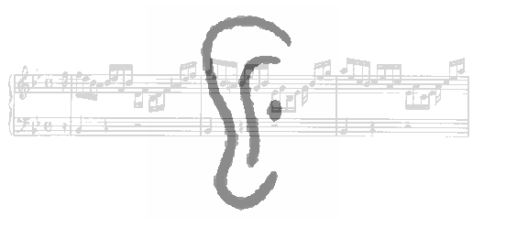
Perception auditive
Daniel Pressnitzer
Laboratoire des Systèmes Perceptifs, CNRS
& Département d’études cognitives, Ecole normale supérieure
29 rue d’Ulm, 75230 Paris cedex 05
daniel.pressnitzer@ens.fr

Slide 2
CogSci 307: Auditory Perception
Daniel Pressnitzer
Laboratoire des Systèmes Perceptifs, CNRS
& Département d’études cognitives, Ecole normale supérieure
29 rue d’Ulm, 75230 Paris cedex 05
daniel.pressnitzer@ens.fr

Slide 3
Overview
I. Methods and concepts acoustics, psychophysics, physiology
II. Basic characteristics and applications audible range, masking, critical band, non-linearities, MP3, implants
III. Perceptual attributes loudness, pitch, timbre, location
IV. Seminar auditory scene analysis, illusions, memory

Slide 4
Plan du cours
I. Bases, méthodes et concepts acoustique, psychophysique, physiologie
II. Caractéristiques élémentaires et applications champ audible, masquage, bande critique, non-linéarités, MP3, implants
III. Attributs perceptifs sonie, hauteur, timbre, localisation
IV. Analyse des scènes auditives organisation auditive, musique
V. Etudes en cours mémoire auditive, effets de contexte
cours2_caracteristiques

Slide 5
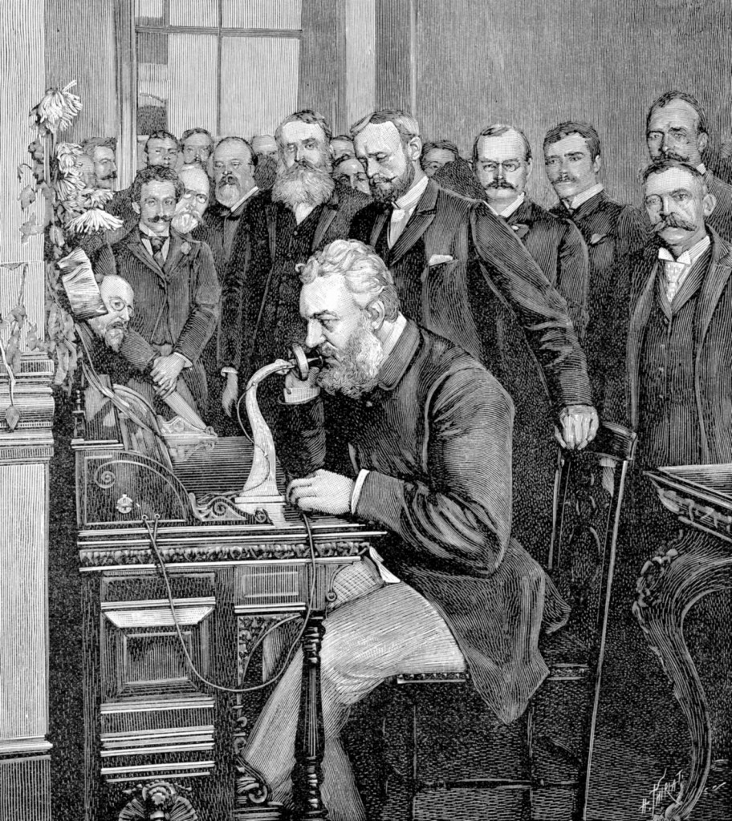
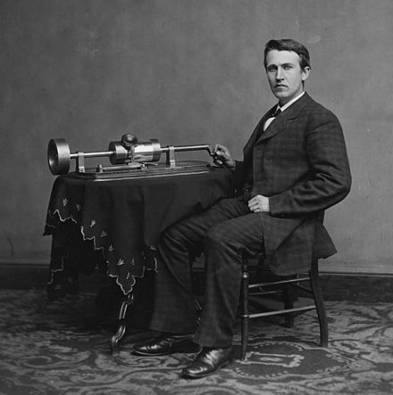
Basic characteristics
Introduction
Helmholtz, Seebeck: tuning forks, resonators, sirens, etc…
1876: Transmit and reproduce sounds, Bell & Edison
Creation of Bell Labs
Transistors, théorie de l’information – et surdité
Yost, 2015

Slide 6
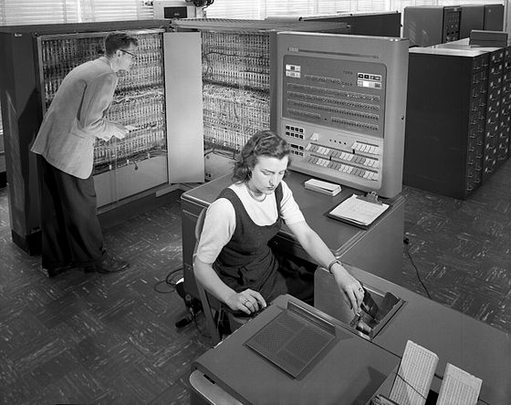
Basic characteristics
Bell Labs
An IBM 704 syntheses the first digital music ever, “In the Silver scale”, by Newman Guttman and Max Mathews

Slide 7
II.1 Caractéristiques élémentaires
Bell Labs
Un IBM 704 synthétise la première musique numérique, “In the Silver scale”, par Newman Guttman et Max Mathews
“Pitch variations”, Newman Guttman, 1957

Slide 8
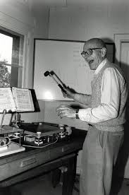
II.1 Caractéristiques élémentaires
Bell Labs
Max Mathews, Science, 1963
Un IBM 704 synthétise la première musique numérique, “In the Silver scale”, par Newman Guttman et Max Mathews
“Pitch variations”, Newman Guttman, 1957
Possibilités techniquement illimitées

Slide 9
Basic characteristics
Bell Labs
Jean-Claude Risset, “Catalog”, 1969
Max Mathews, Science, 1963
“Pitch variations”, Newman Guttman, 1957
Limitless possibilities
Compose sound itself: link to auditory perception

Slide 10
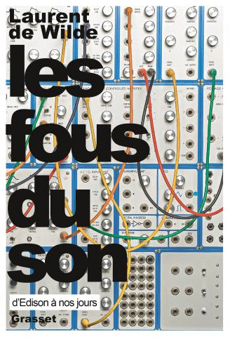
Basic characteristics
Digression…

Slide 11
Overview
I. Methods and concepts acoustics, psychophysics, physiology
II. Basic characteristics and applications audible range, masking, critical band, non-linearities, MP3, implants
III. Perceptual attributes loudness, pitch, timbre, location
IV. Seminar auditory scene analysis, illusions, memory

Slide 12
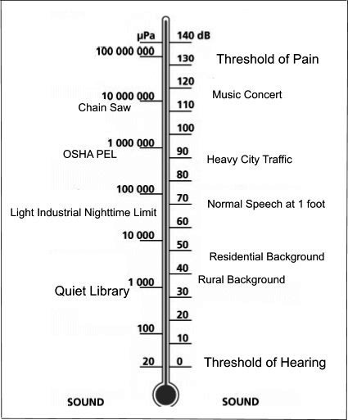
Basic characteristics
Existence region of sound? dB SPL

Slide 13
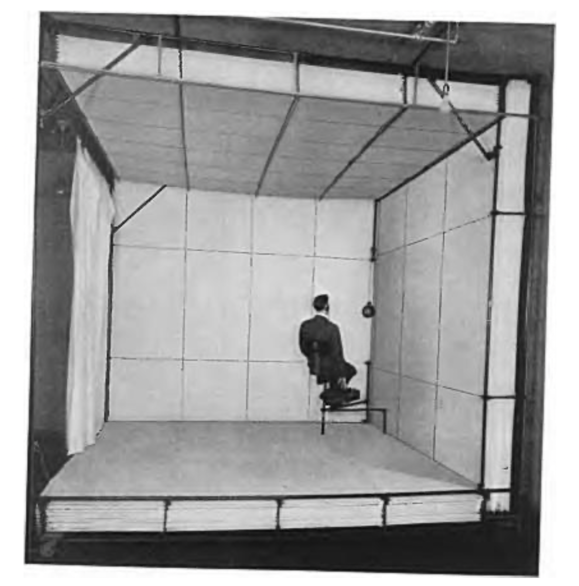
Basic characteristics
Audibility threshold
What is the smallest sound intensity that can be perceived?

Slide 14
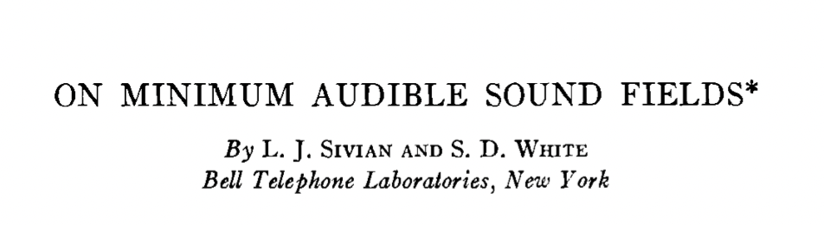
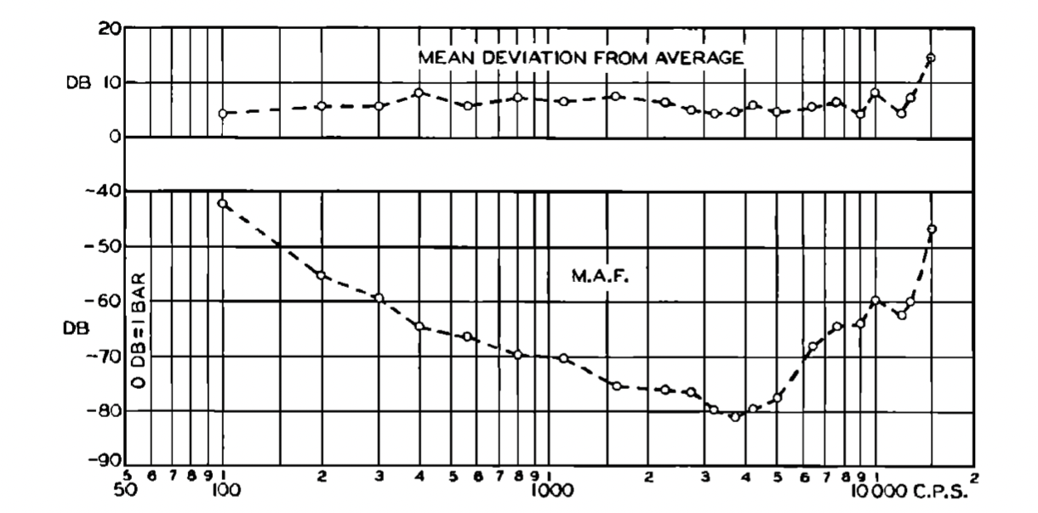
Basic characteristics
Measured with pure tones at different frequencies
Audibility threshold depends on frequency

Slide 15
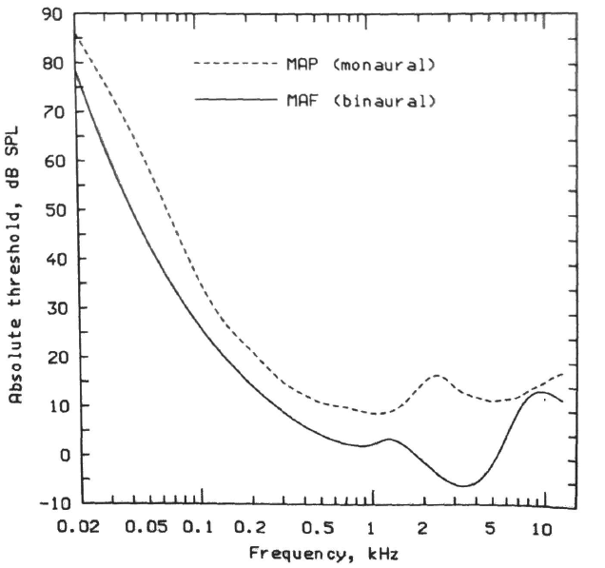
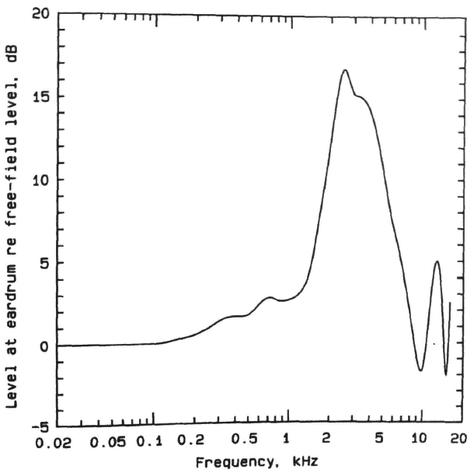
Basic characteristics
Minimum audible pressure vs mínimum audible field
Killion, 1978; Shaw, 1974; reprinted in Moore, 2013

Slide 16

Basic characteristics
Demo [ASA 17]:
Pure tones at 125, 250, 500, 1000, 2000, 4000 et 8000Hz
Decreasing intensity, 5dB steps for all frequencies
Count how many steps you can hear?

Slide 17
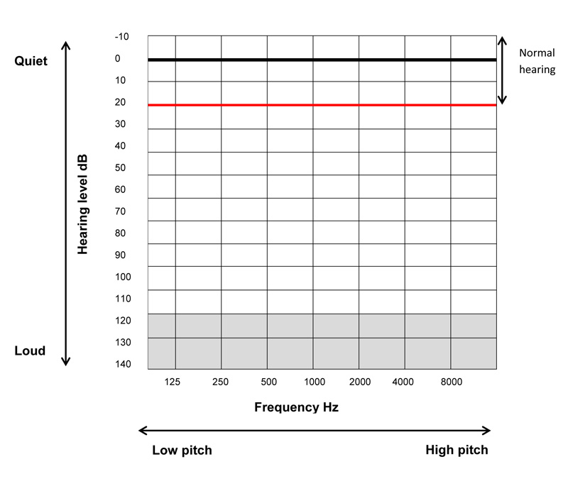
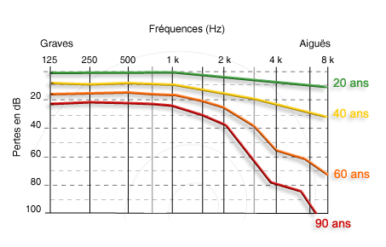
Basic characteristics
Audiogram
Clinical scale: dB HL (Hearing Level)
Presbyacousis

Slide 18
Basic characteristics
Audiogram
Link between behavioral thresholds auditory nerve activity
?!??
Joris et al., 2011

Slide 19
Overview
I. Methods and concepts acoustics, psychophysics, physiology
II. Basic characteristics and applications audible range, masking, critical band, non-linearities, MP3, implants
III. Perceptual attributes loudness, pitch, timbre, location
IV. Seminar auditory scene analysis, illusions, memory

Slide 20
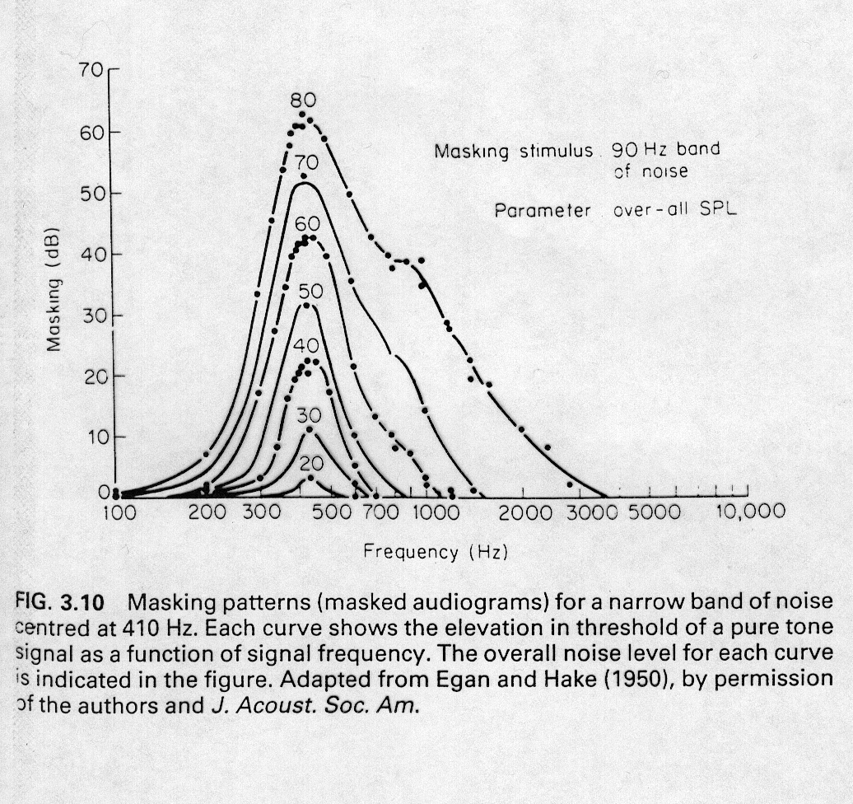
Basic characteristics
Simultaneous masking
A
f

Slide 21
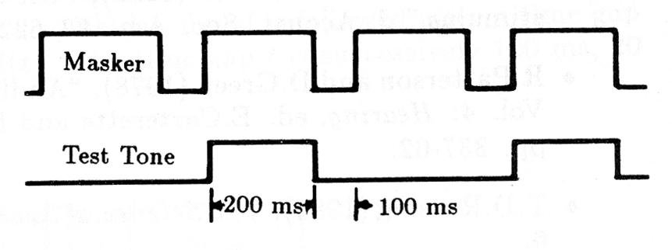
Basic characteristics
Simultaneous masking
Demo [ASA 22]: Tone with decreasing amplitude + masker
How many steps can you hear?
A) Masker = 1200Hz, Signal = 2000Hz
B) Masker = 2000Hz, Signal = 1200Hz

Slide 22
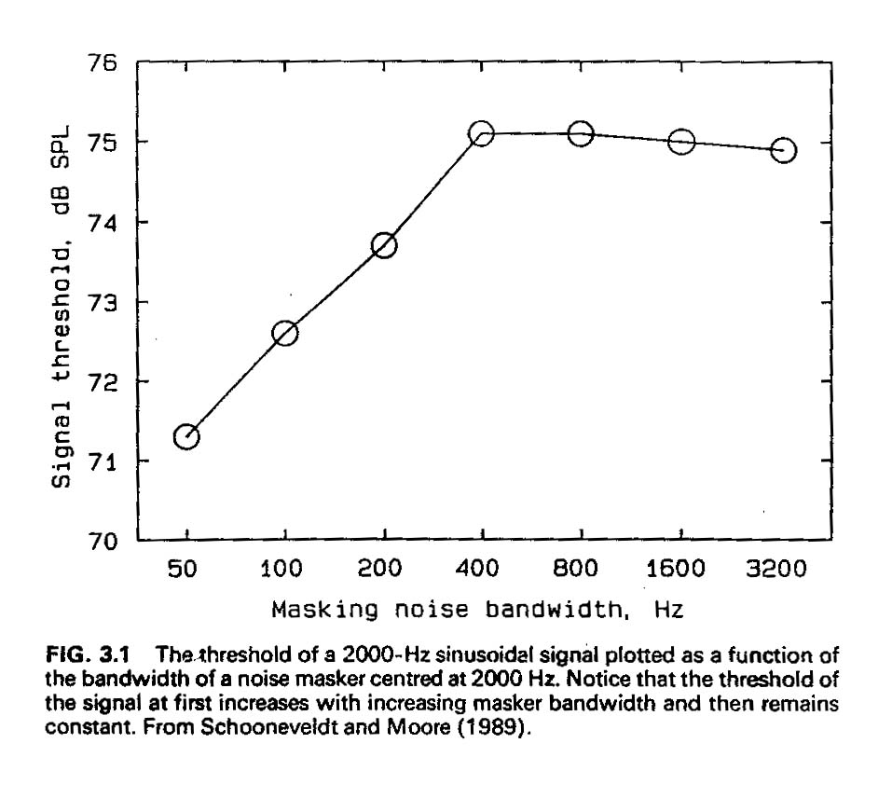
Basic characteristics
The critical band
A
f

Slide 23
Basic characteristics
The critical band
Demo [ASA 2-6]
Signal: pure tone at 2000Hz
A) signal alone
B) masked by broadband noise
C) masked by noise with bandwidth 1000Hz
D) bandwidth 250Hz
E) bandwidth 10Hz

Slide 24
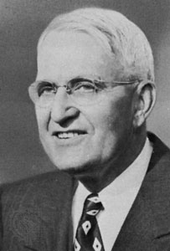
Basic characteristics
Harvey Fletcher, Speech and Hearing (1922)

Slide 25
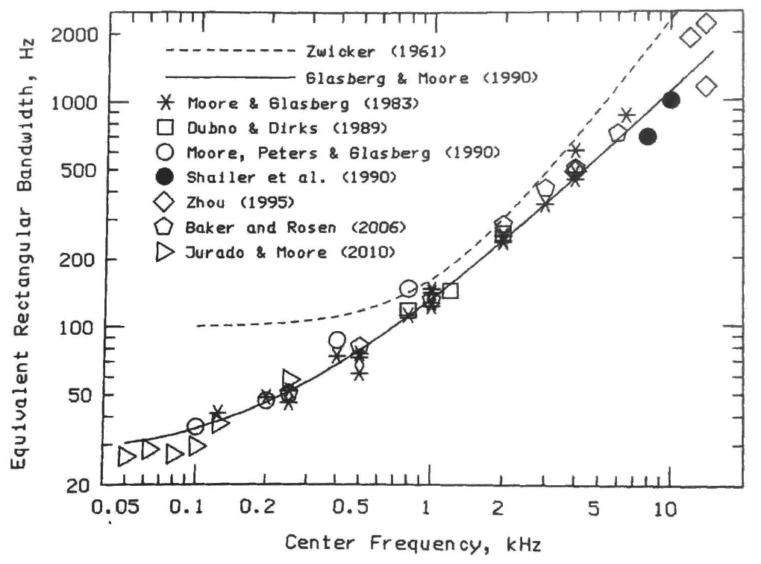
Basic characteristics
The critical band

Slide 26
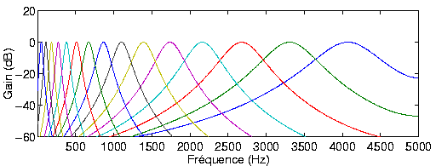
Basic characteristics
The critical band
Auditory filters

Slide 27
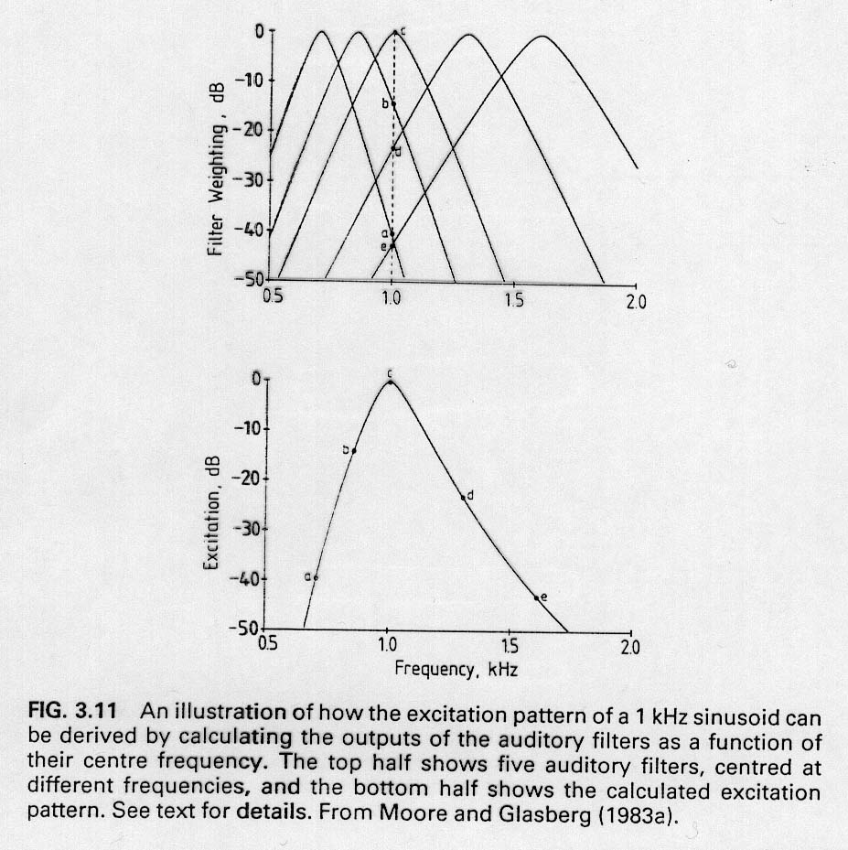
Basic characteristics
The critical band
Auditory filters
Used to predict masking

Slide 28
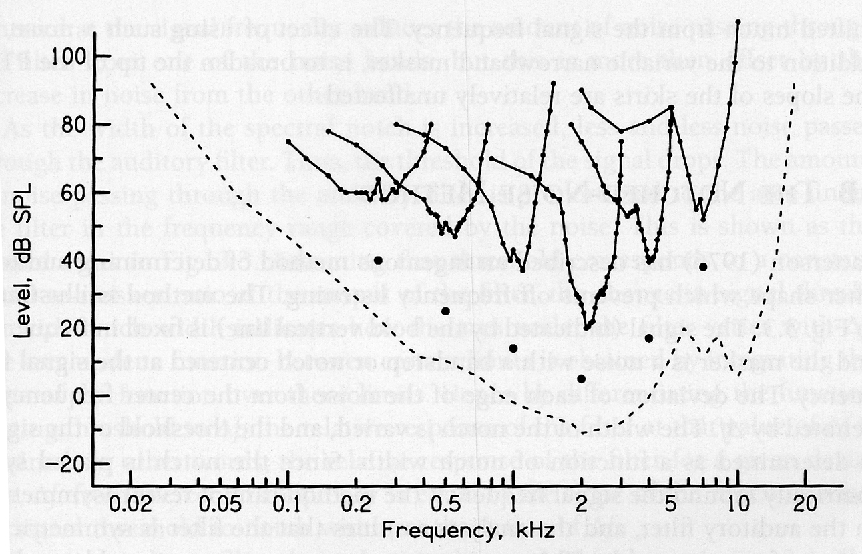
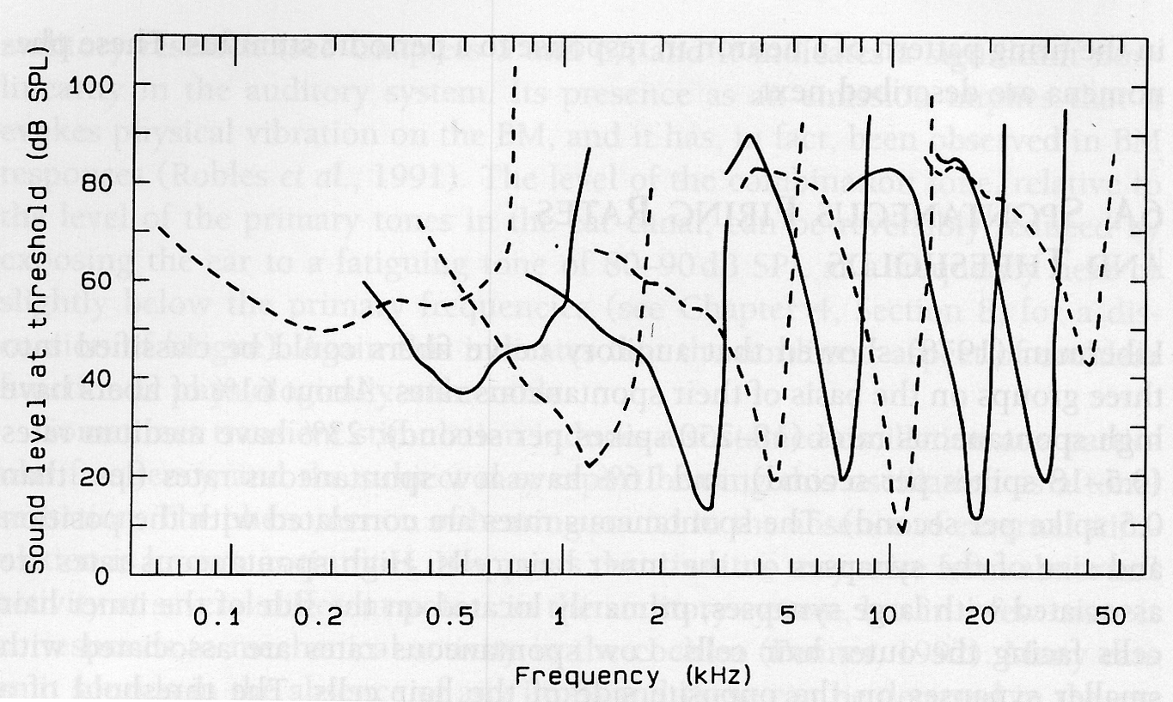
II.2 Masquage simultané
A
f

Slide 29
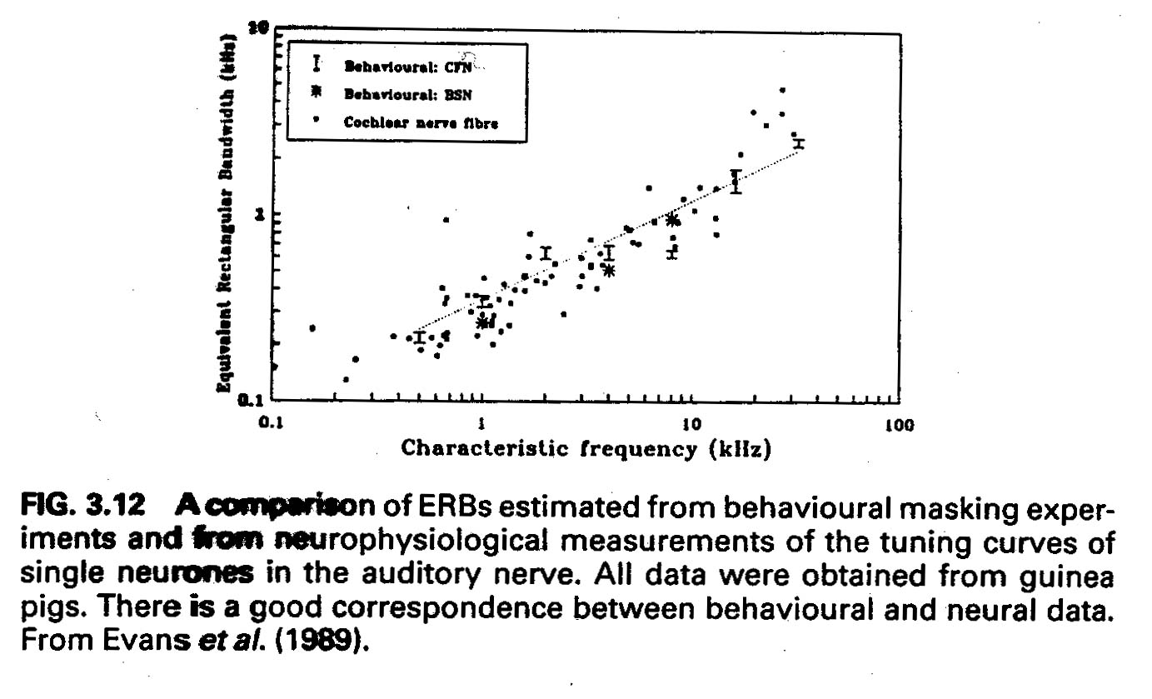
Basic characteristics

Slide 30
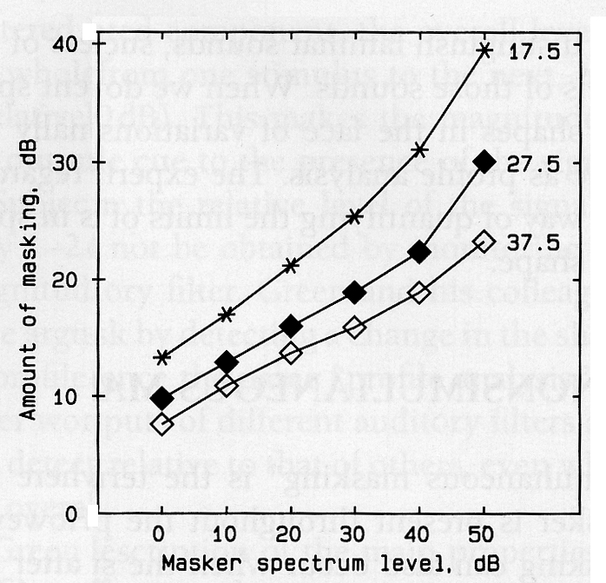
Basic characteristics
Temporal masking: forward
A
t
Moore & Glasberg, 1983

Slide 31
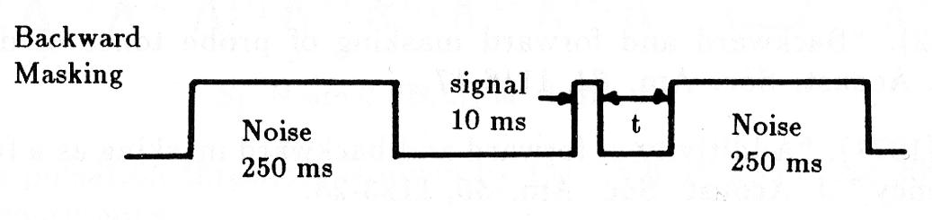
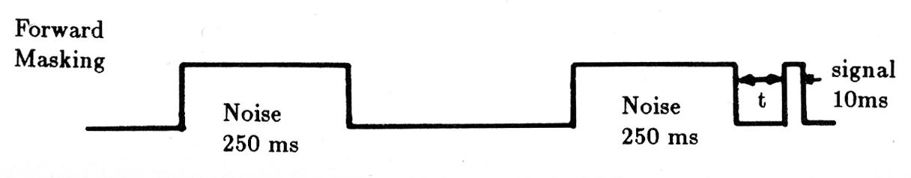
Basic characteristics
Temporal masking: forward and backward
Demo [ASA 23-25]
A) Signal alone
B) Signal followed (t=100ms, 20ms, 0ms) by masker
C) Signal preceded by noise

Slide 32
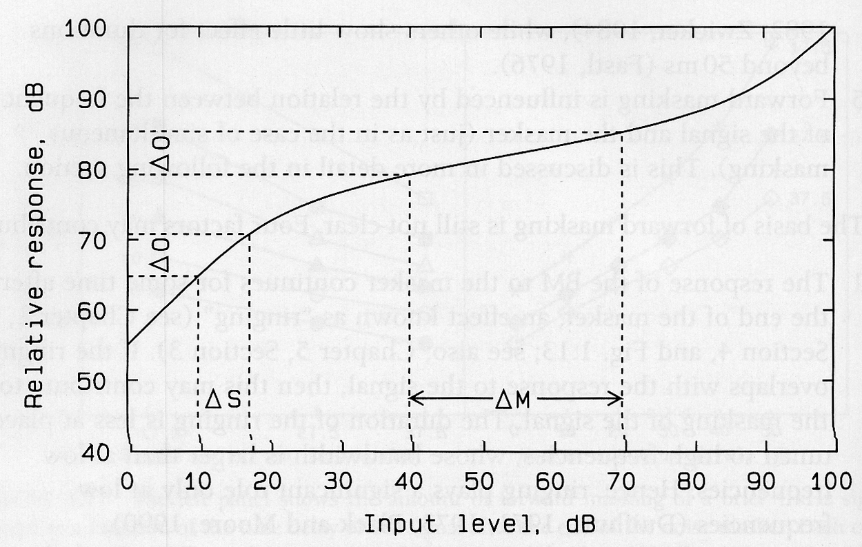
II.3 Masquage temporel
Masquage pro-actif
Existence d’un mécanisme de “compression”

Slide 33
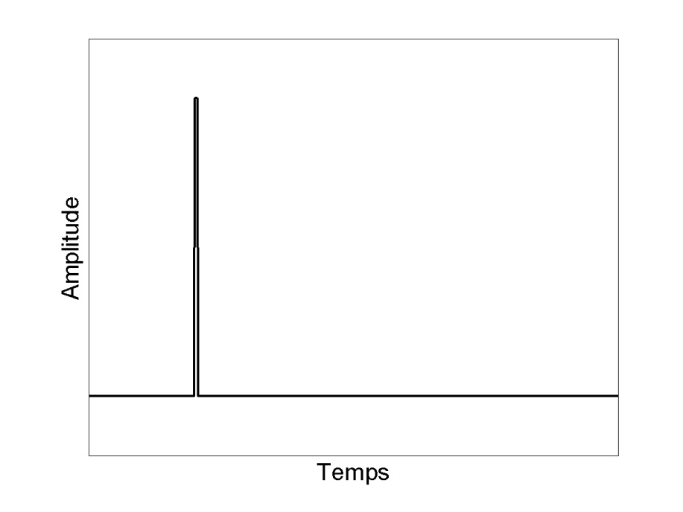
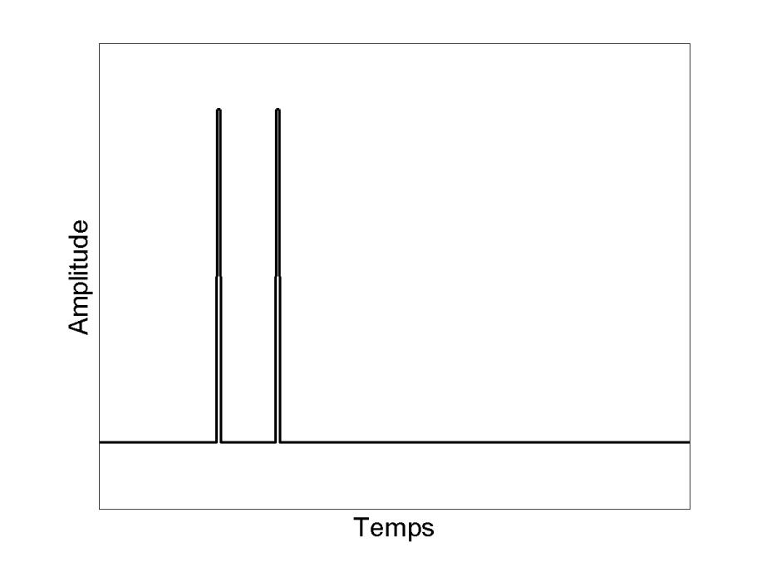
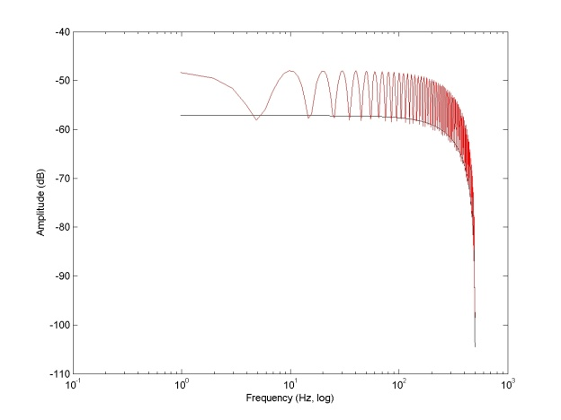
II.4 Résolution temporelle
Intuitivement: séparer deux évènements dans le temps
Paires de clicks: ~ 20 microsec
… mais indices spectraux

Slide 34
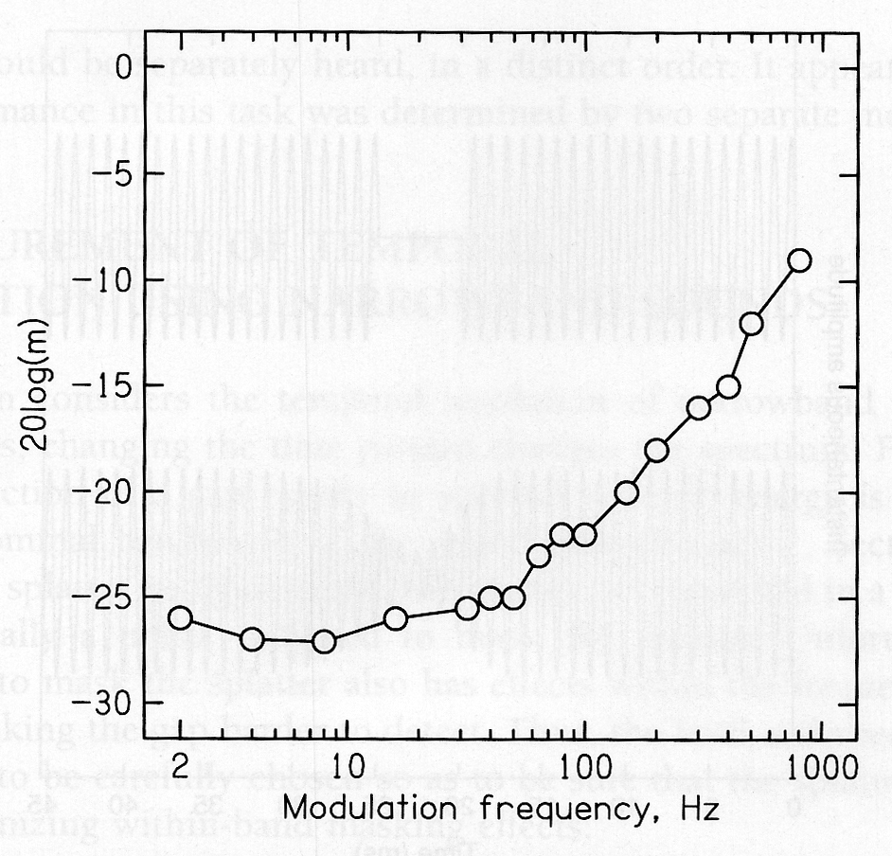
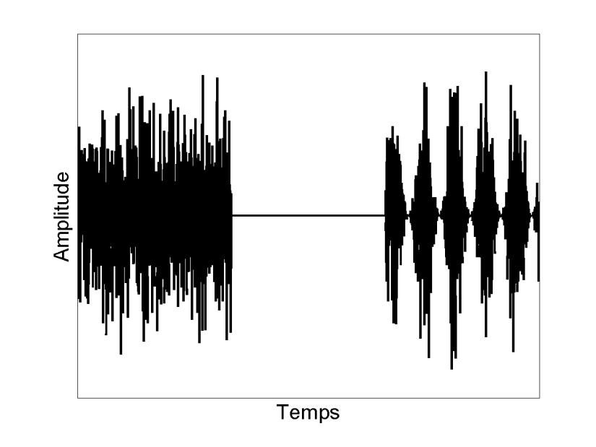
Basic characteristics
Temporal resolution
Amplitude modulation detection
Temporal Modulation Transfer Function
m
f_{m}
Viemeister, 1979

Slide 35
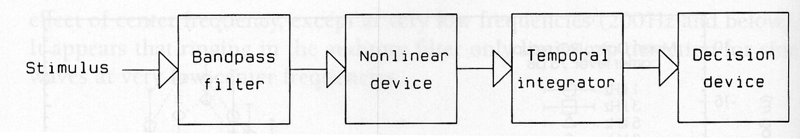
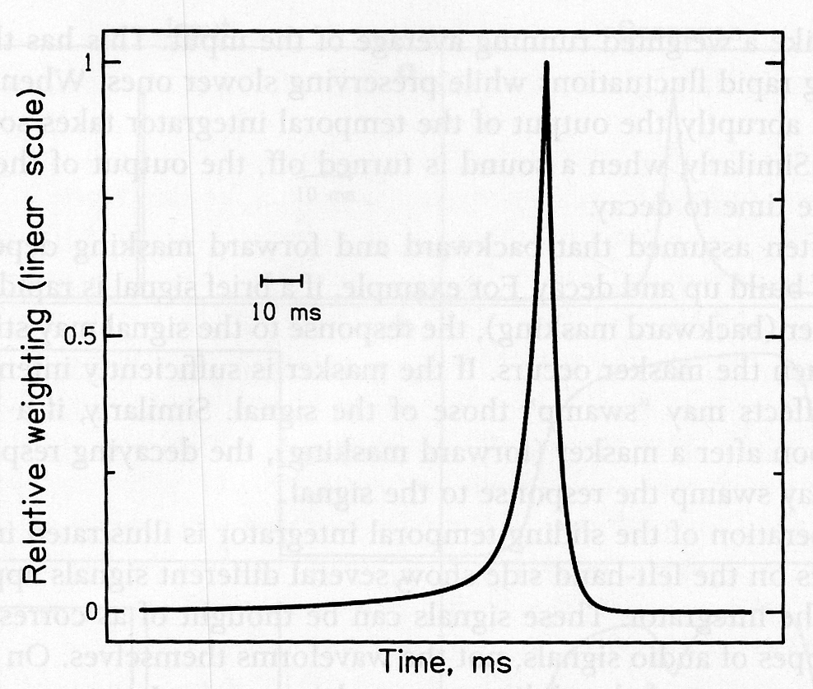
Basic characteristics
Temporal resolution
Temporal integration model
Plack & Moore, 1990

Slide 36
Overview
I. Methods and concepts acoustics, psychophysics, physiology
II. Basic characteristics and applications audible range, masking, critical band, non-linearities, MP3, implants
III. Perceptual attributes loudness, pitch, timbre, location
IV. Seminar auditory scene analysis, illusions, memory

Slide 37
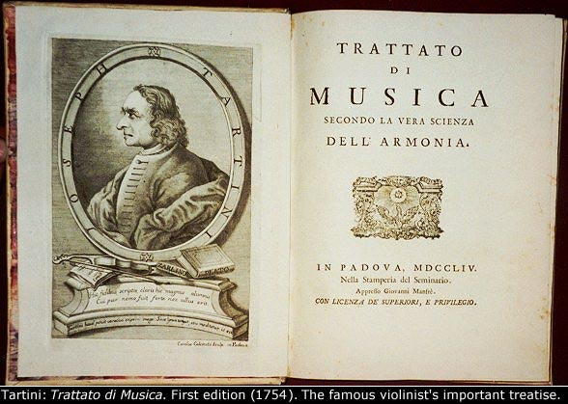
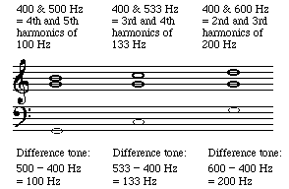
Basic characteristics
Distortion products

Slide 38
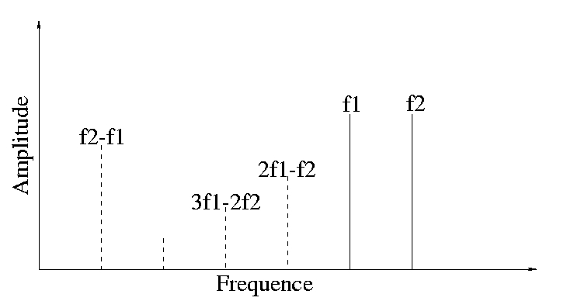
Basic characteristics
Distortion products
Two pure tones at f1 and f2
Quadratique
Cubique

Slide 39
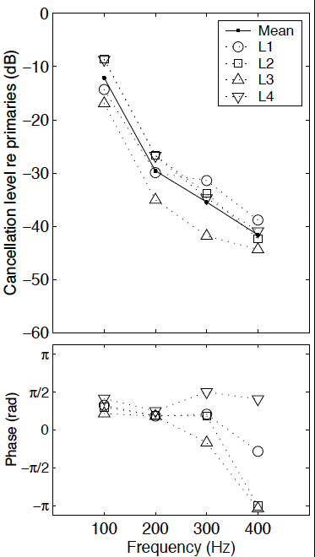
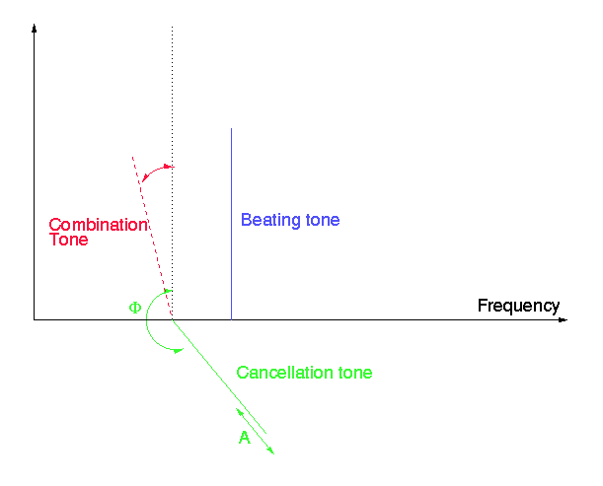
Basic characteristics
Distortion products
Behavioral measure
10 primaires Pressnitzer & Patterson, 2001

Slide 40
Basic characteristics
Distortion products
Demo [ASA 68]
Two pure tones at 1000Hz et 1200Hz
A third tone added at 804Hz
Nb: 2f1-f2 = 800Hz….

Slide 41
Basic characteristics
f1
f2
2f1-f2
1200
2000
2800
Frequency in Hz
primary tone f₁
primary chirp f₂
f₁ and f₂
Demo from Stefan Uppenkamp

Slide 42
Basic characteristics
f1
f2
2f1-f2
1200
2000
2800
Frequency in Hz
primary tone f₁
primary chirp f₂
f₁ and f₂

Slide 43
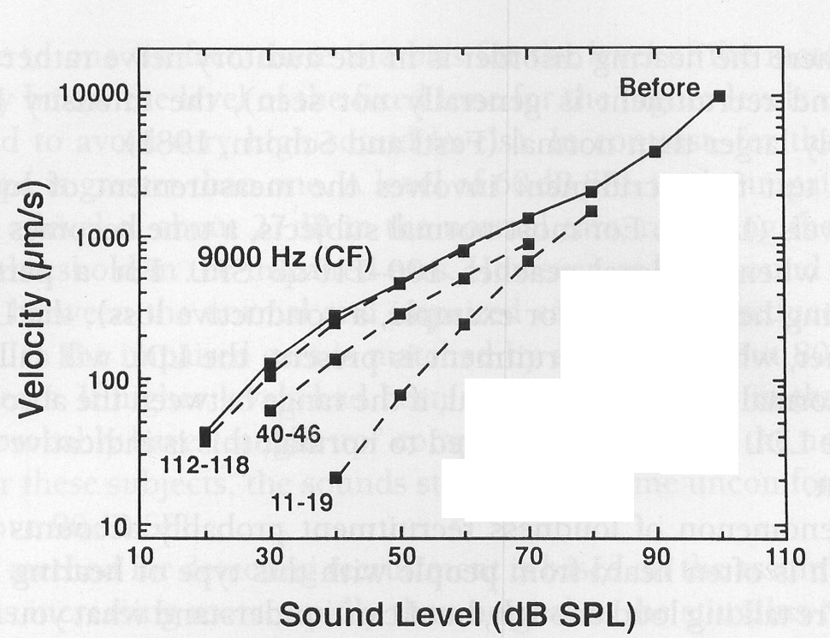
Basic characteristics
Compression mechanism in the cochlea

Slide 44
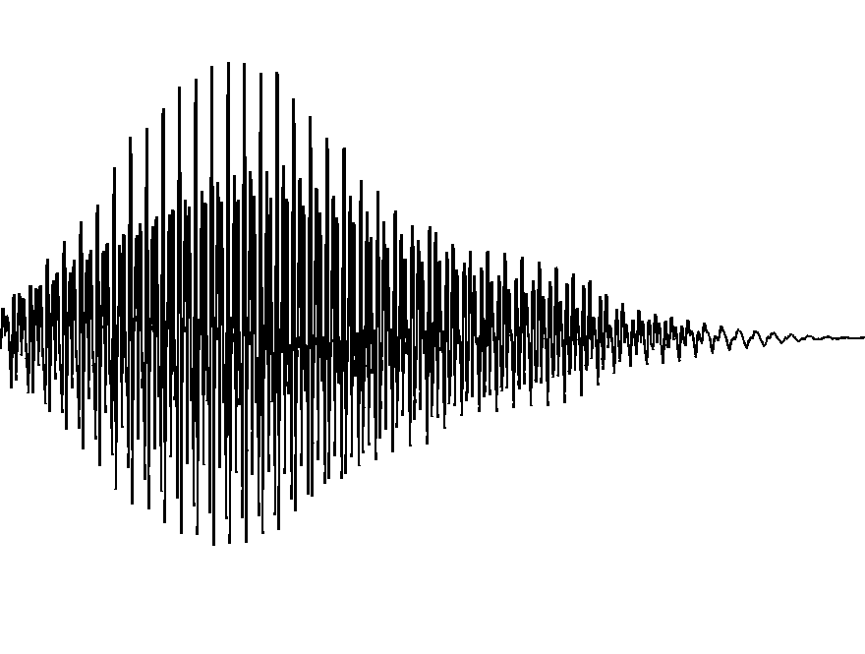
Models
Pré-emphase
Banc de filtre
Compression
Passe-bas
A
A
A
f
A
f
Oreille ext/moy
Membrane basilaire
Mécanisme actif
Res. temp.

Slide 45
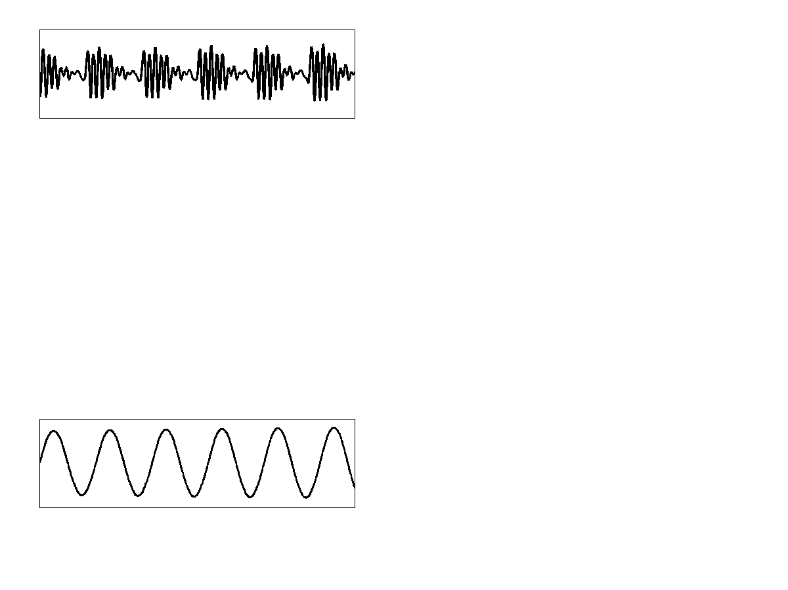
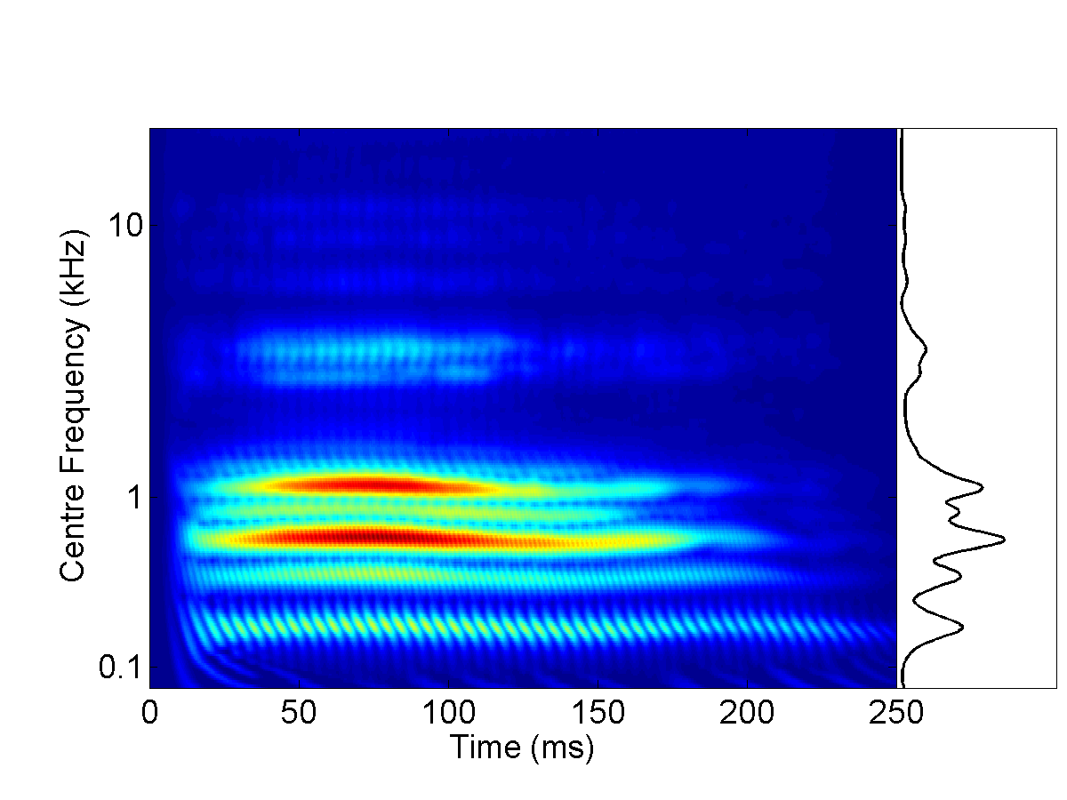
Models
Envelope
Excitation pattern
Fine structure

Slide 46
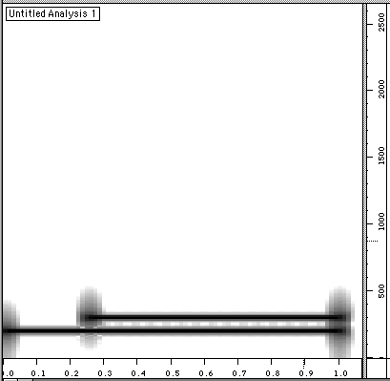
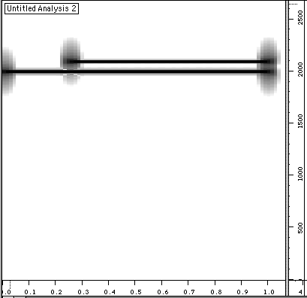

Models

Slide 47
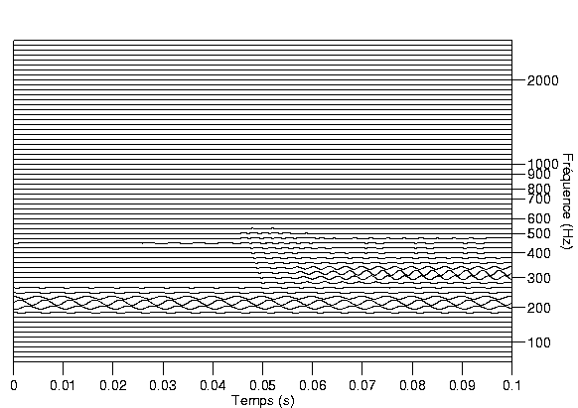
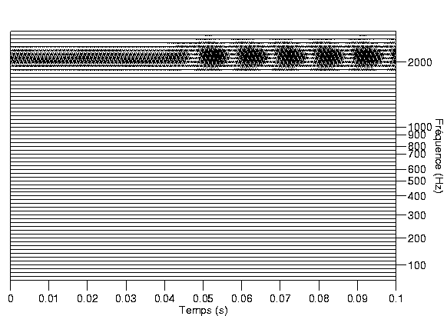
Models

Slide 48
Overview
I. Methods and concepts acoustics, psychophysics, physiology
II. Basic characteristics and applications audible range, masking, critical band, non-linearities, MP3, implants
III. Perceptual attributes loudness, pitch, timbre, location
IV. Seminar auditory scene analysis, illusions, memory

Slide 49
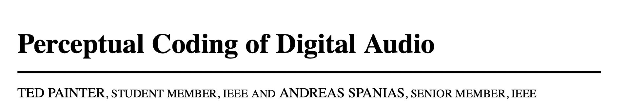
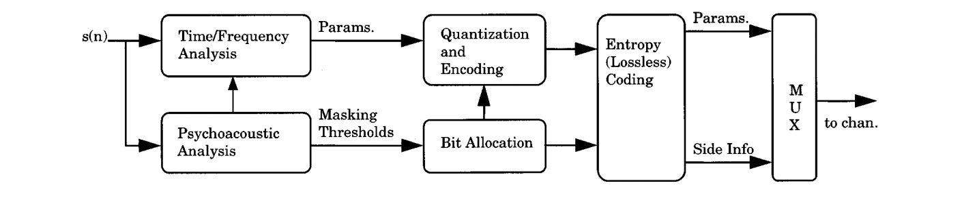
Applicatiom
Multi-billion $S industries
Sound representation taking perception into account
MP3, speech coding for telecommunications, etc…

Slide 50

Applications
Codage audio: MP3
mono@48kHz

Slide 51
Applications
MP3
CD stereo: 44.1*16*2 = 1410 kbps
Compression MP3 (Lame, www.mp3dev.org)
256 kbps
128 kbps
64 kbps
32 kbps
Residual noise
Comparison: fs = 8kHz (256 kbps)
fs = 4kHz (128 kbps)
8 bits (512 kbps)

Slide 52


Applications
Otoemissions
Acoustic measure of the active mechanism
Kemp, 1977

Slide 53

Applications
Otoemissions

Slide 54


Applications
Otoemissions
Correlation with hearing loss

Slide 55
Applications
Indirect measure of selectivity
Link between OAE delay and selectivity
Are humans special?
Joris et al., 2011

Slide 56
Applications
Spontaneous otoemissions
Oreille avec SOAE
Coupleur

Slide 57
Overview
I. Methods and concepts acoustics, psychophysics, physiology
II. Basic characteristics and applications audible range, masking, critical band, non-linearities, MP3, implants
III. Perceptual attributes loudness, pitch, timbre, location
IV. Seminar auditory scene analysis, illusions, memory

Slide 58

Applications
Cochlear implants

Slide 59

Applications
Cochlear implants

Slide 60

Applications
Cochlear implants
Simulations of the processing algorithm
#Bands 1 2 3 4 6 8

Slide 61
Applications
Cochlear implants

Slide 62


Applications
Multiple cues to speech
Envelope
Shannon et al., 1995

Slide 63

Applications
Multiple cues to speech
Temporal fine structure
Lorenzi et al., 2006; Smith et al., 2002

Slide 64




Applications
Multiple cues to speech
Formant frequencies (sine-wave speech)
Remez et al., 1981

